Slide 1


GovShine: A LLM for the Public
Team Name:- ENOXERS
Team Members:-
Devansh Sharma- Frontend
Mrityunjay Kumar- UI/UX Designing
Sujeet Yadav- LLM, Backend
Tushar Kumar Gupta- Data fetching, cleaning & merging
Uday Pratap Singh- Data cleaning & merging

Slide 2
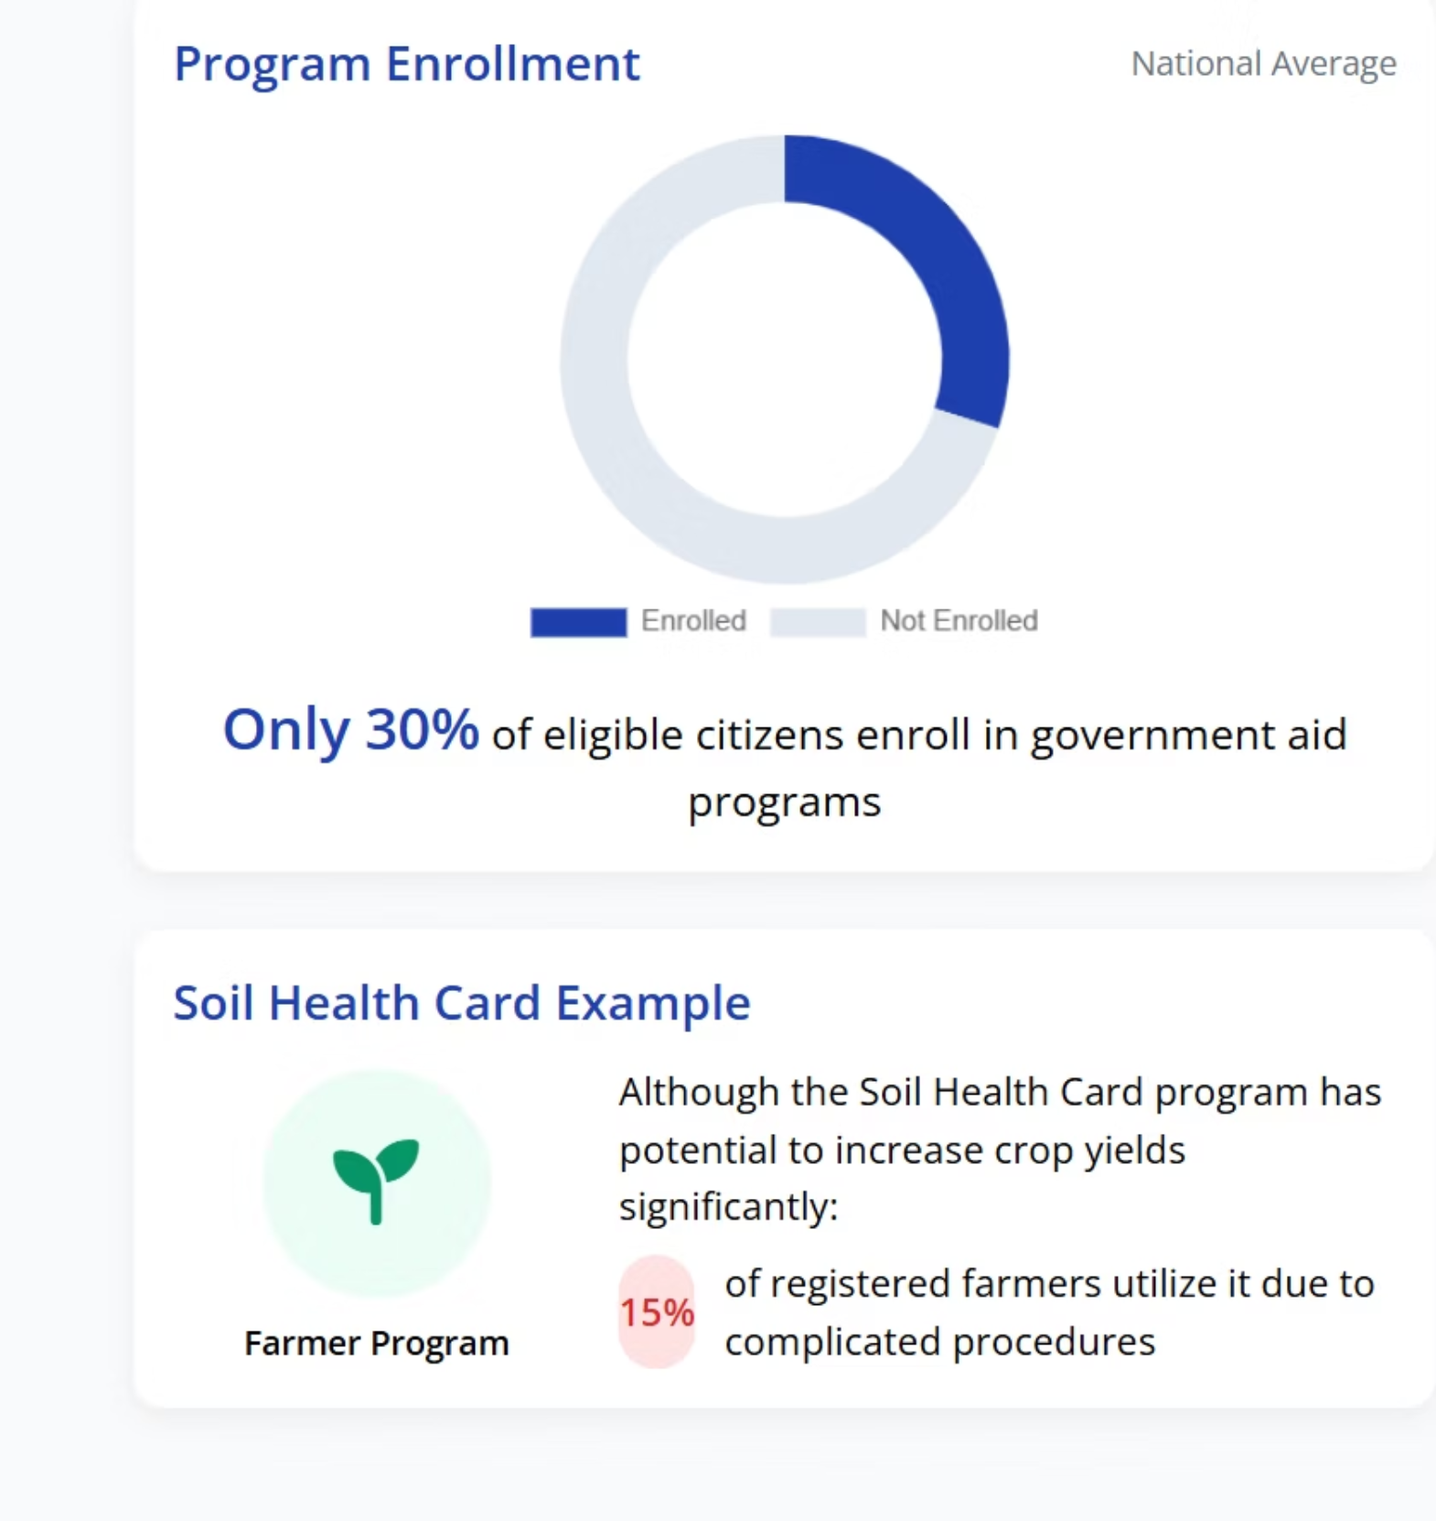
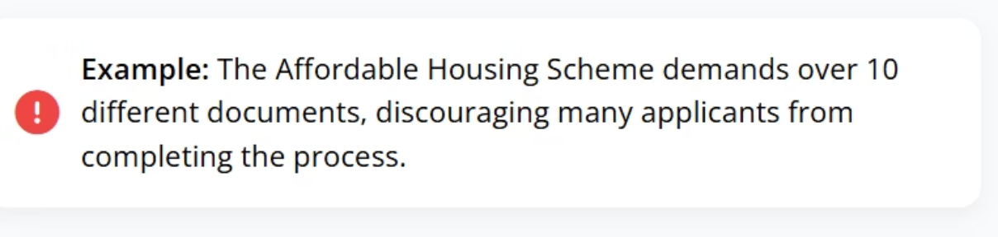
This problem is significant as there is underutilization of Government programs because of
limited awareness
Complex Application Process
Confusing Information

Slide 3
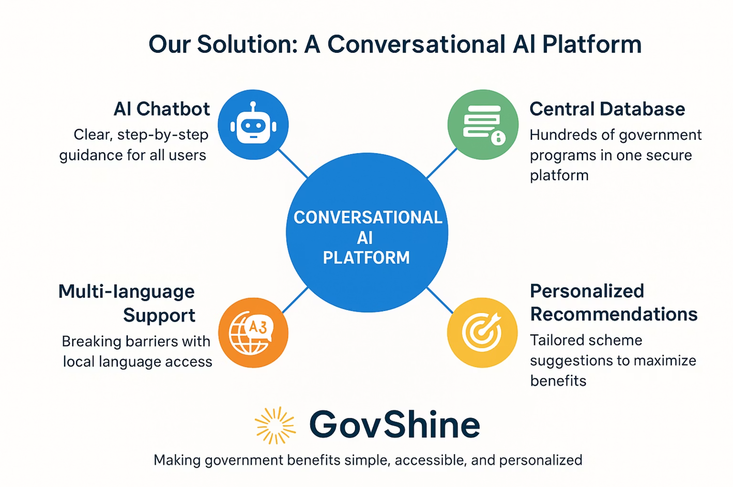
GovShine is an AI-powered unified platform that simplifies access to government schemes by
analyzing user profiles
identifying eligibility
guiding citizens to the right programs
eliminating confusion and ensuring more people receive the benefits they deserve.

Slide 4
Start Big
1
Introduce GovShine as an emerging solution for empowering citizens to access government schemes.
Identify the Problem
2
Highlighting issue of underutilization of government programs and the need for personalized guidance.
Showcase the Solution
3
Pointing the key features of our conversational AI platform that address this challenge.
Personalize the Experience
4
Emphasis on how it's guidance empowers citizens to navigate government programs.
Discuss the Technology
5
Explanation of the secure and scalable architecture ensuring GovShine platform as useful AI.

Slide 5
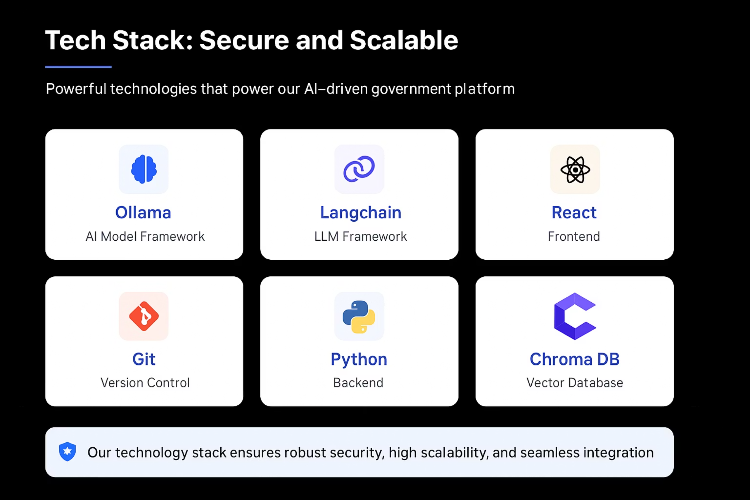

Slide 6
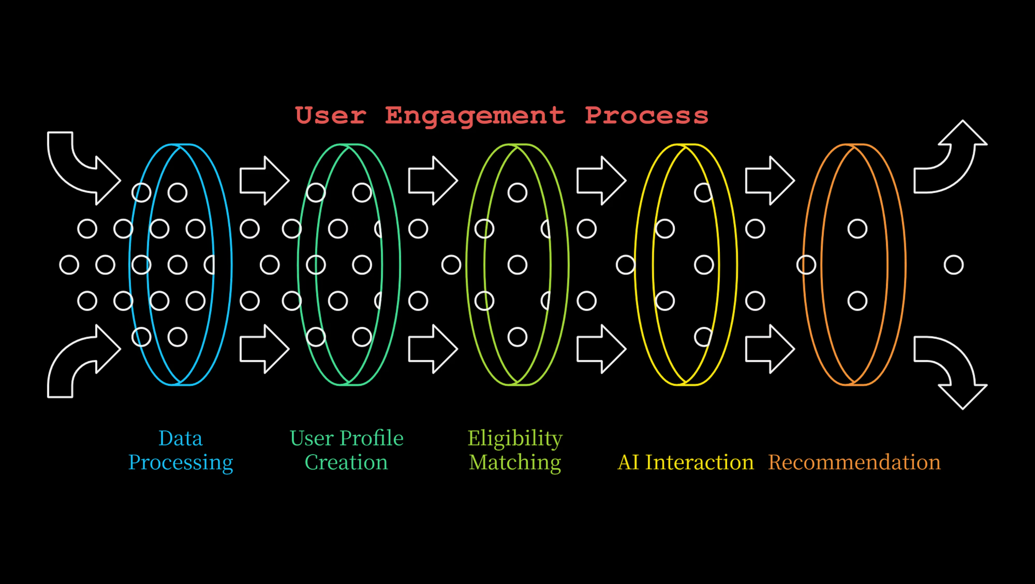

Slide 7
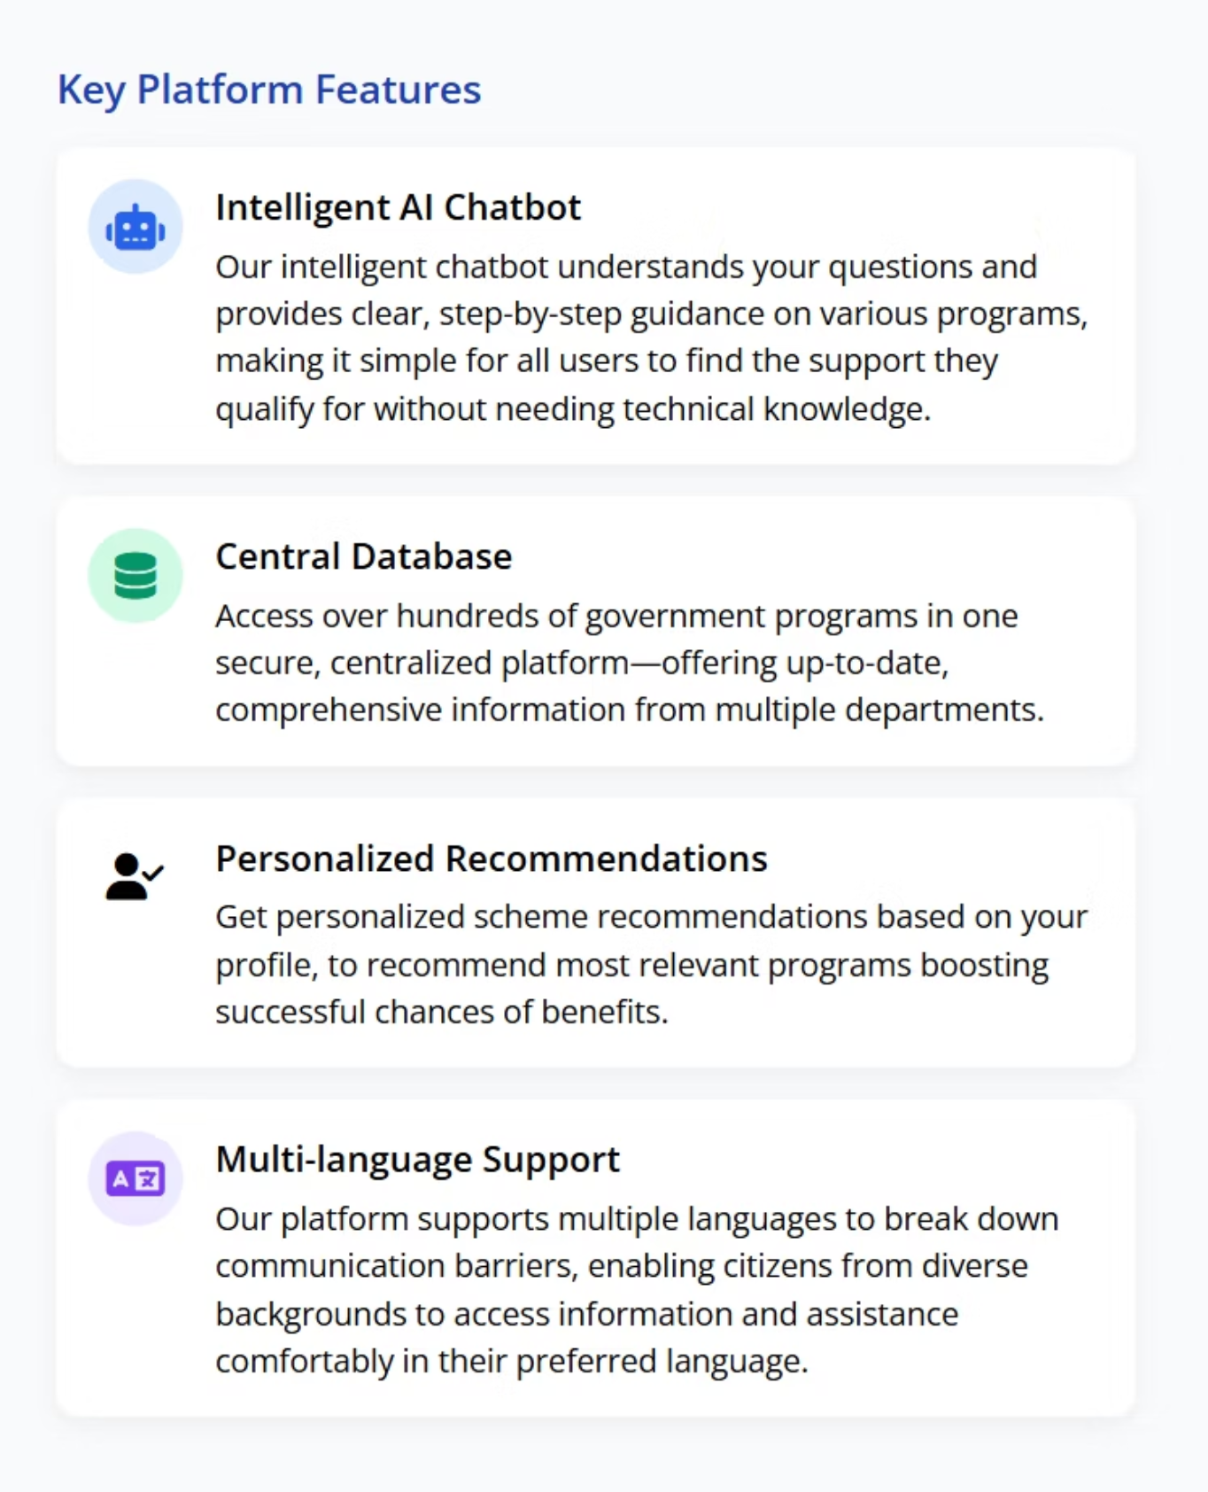
The innovation of GovShine is that we made a chatbot
for the unscattered data which was present and
merged it up for the public to benefit

Slide 8
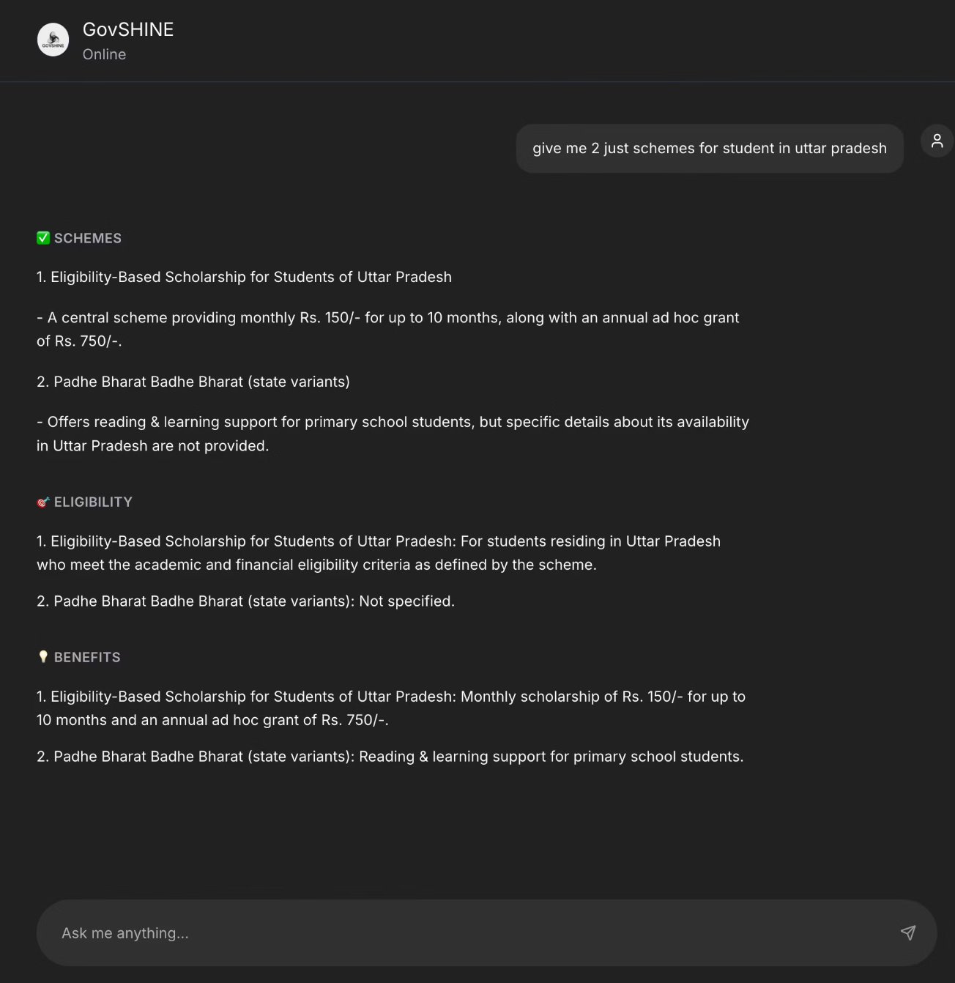
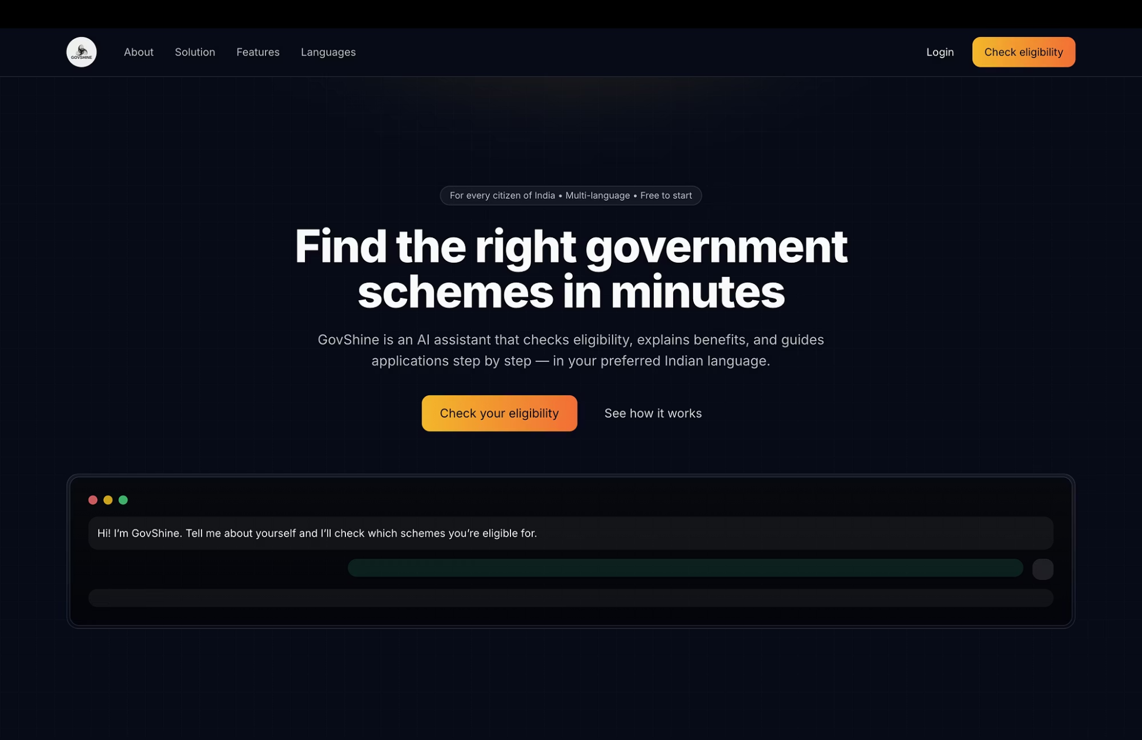

Slide 9
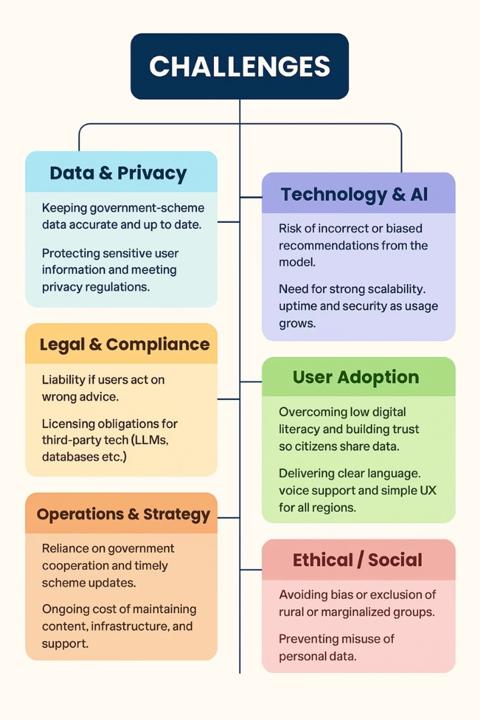
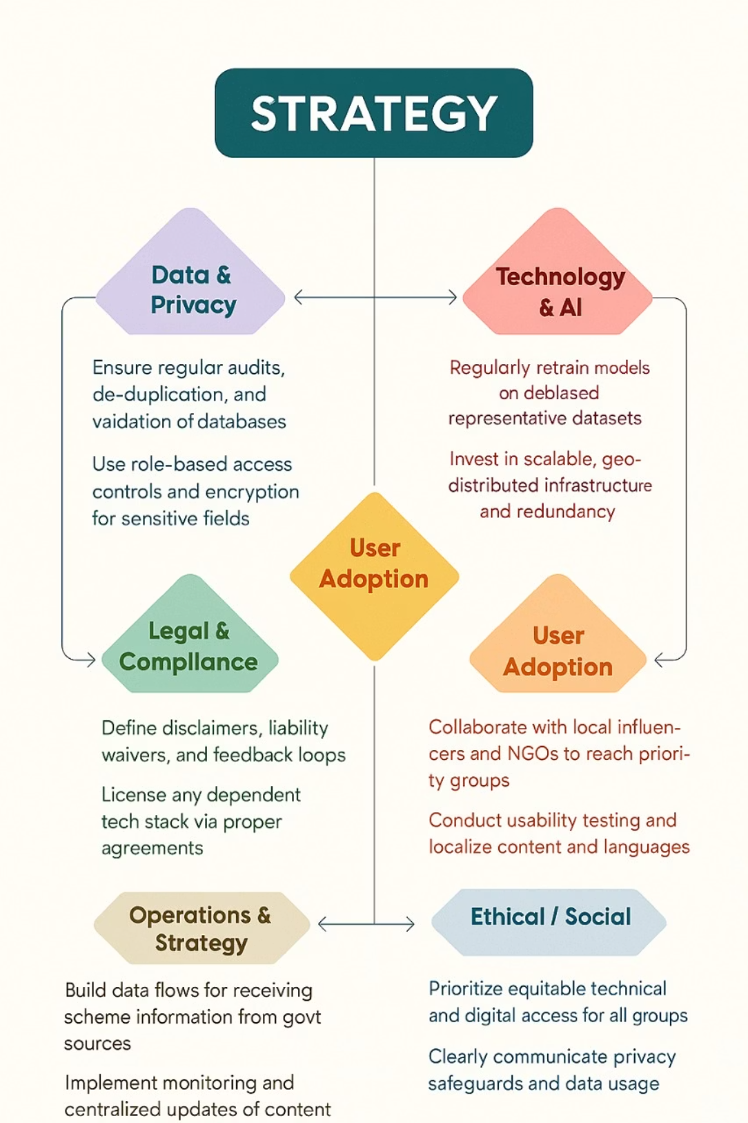

Slide 10
